Slide 1

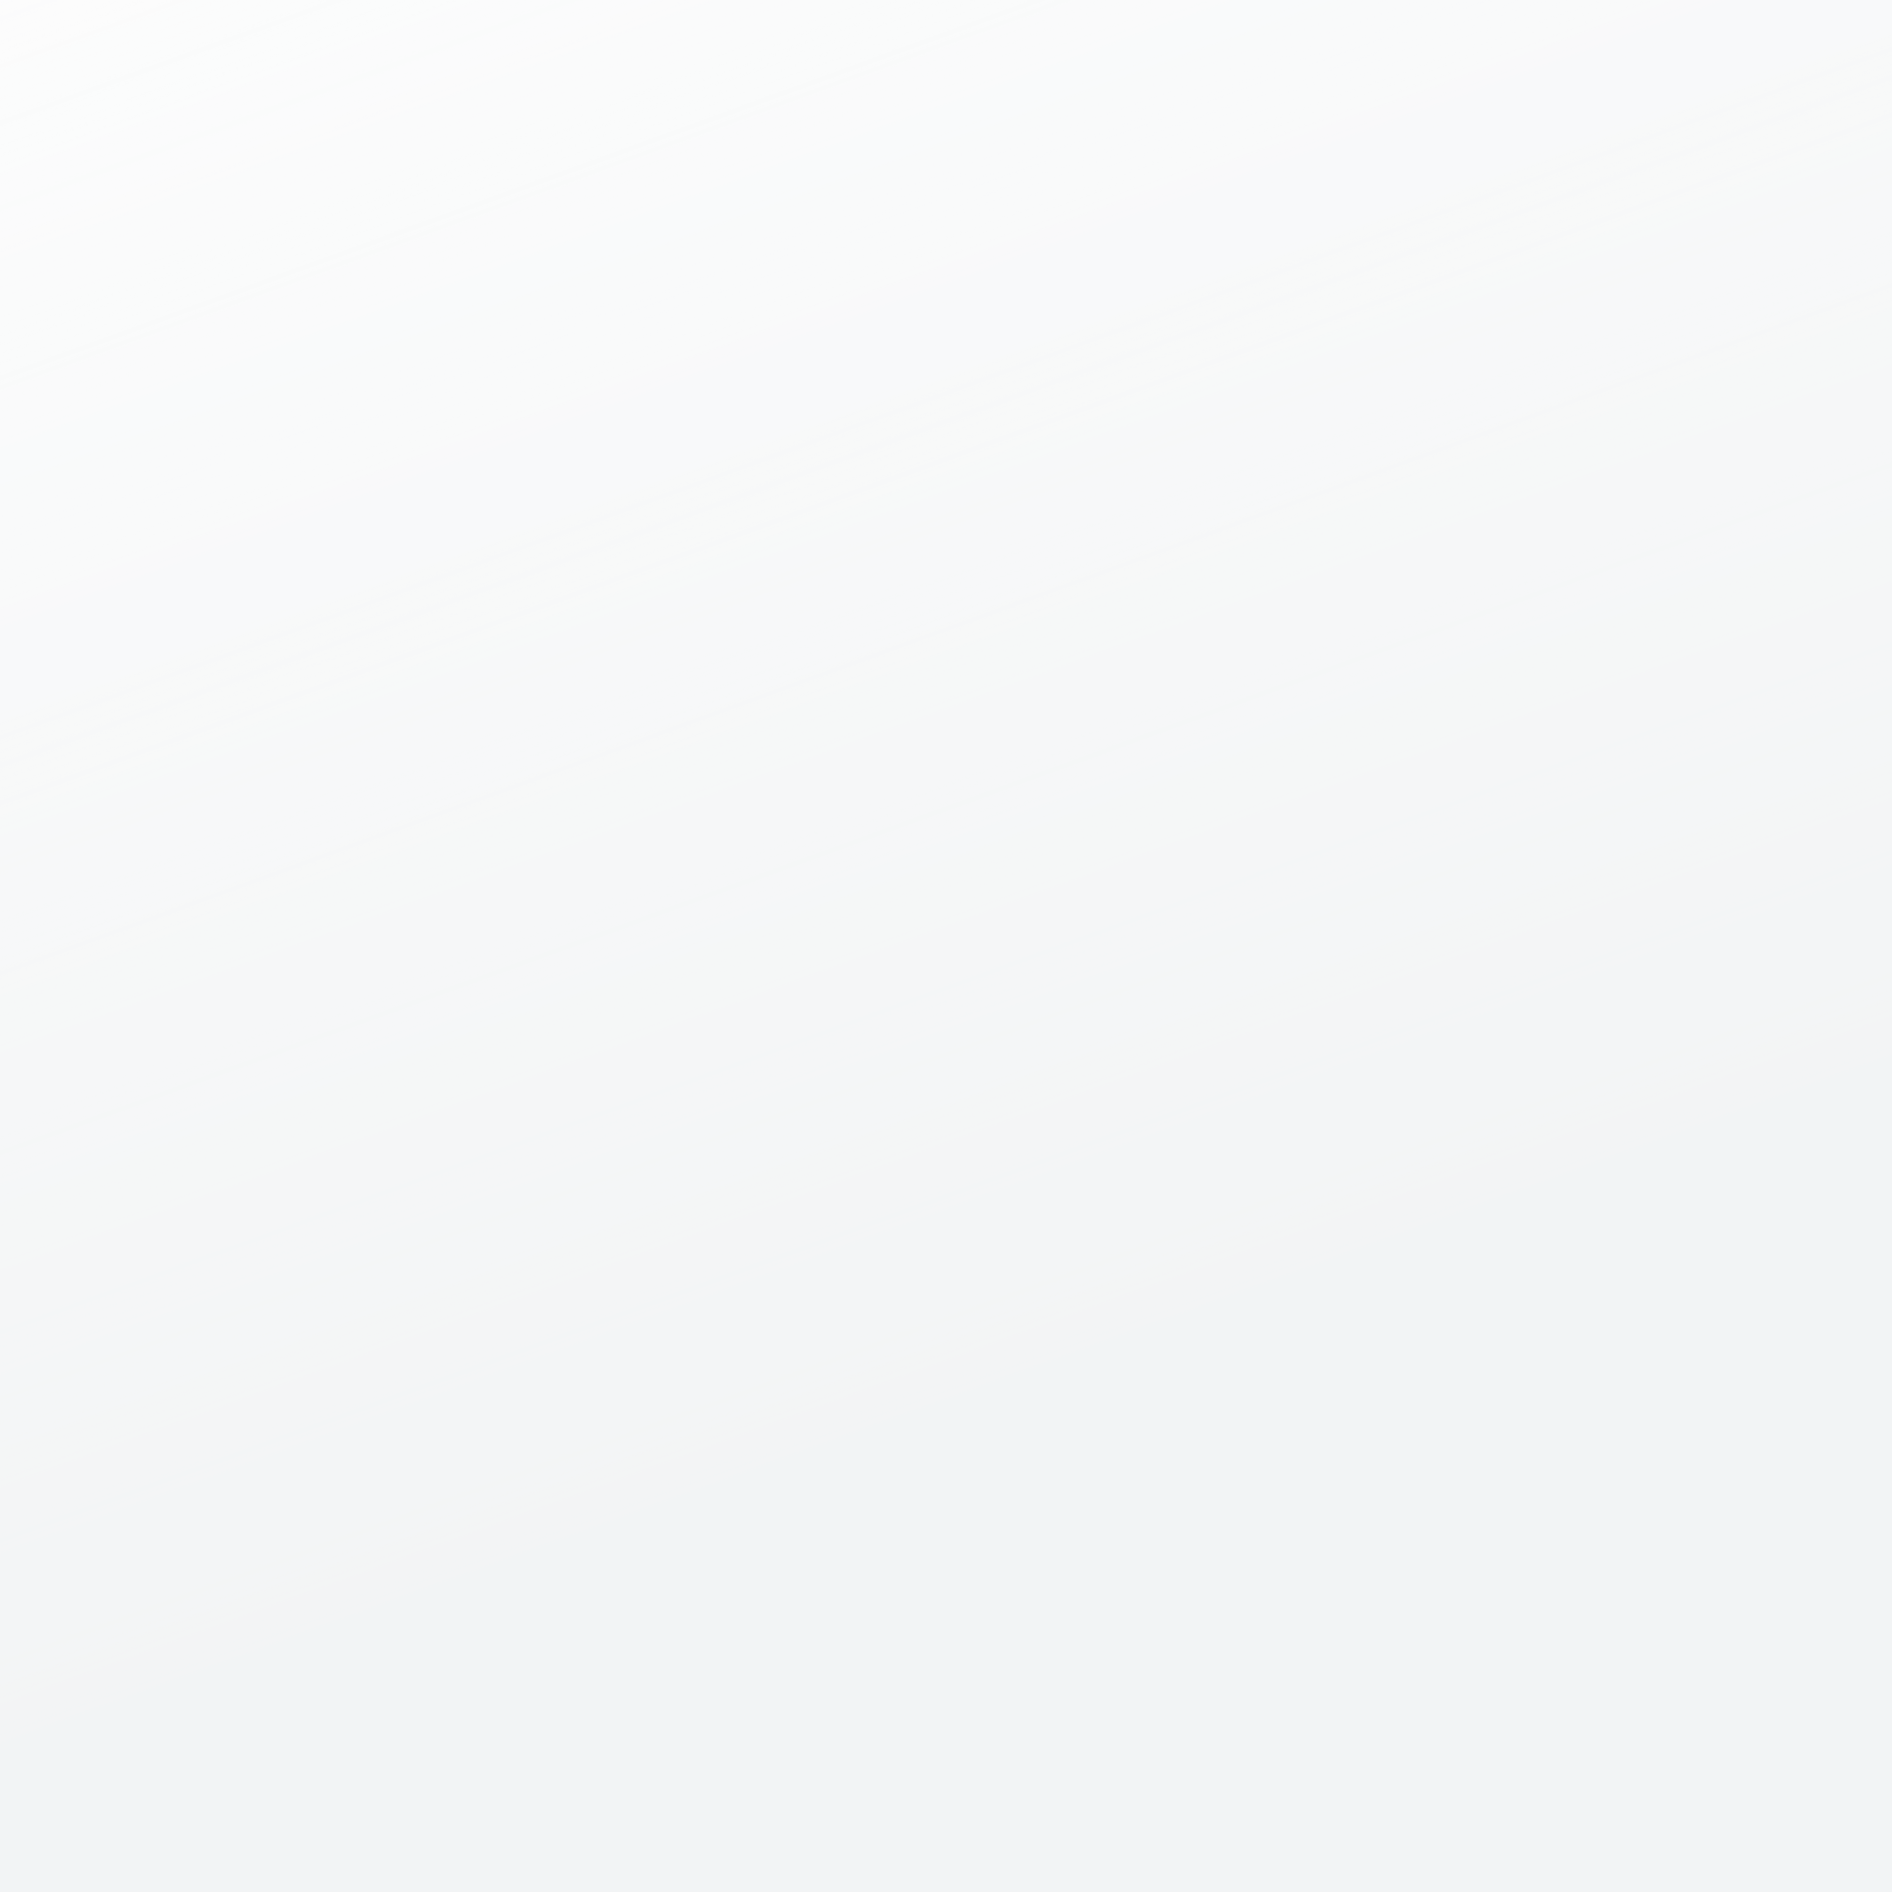
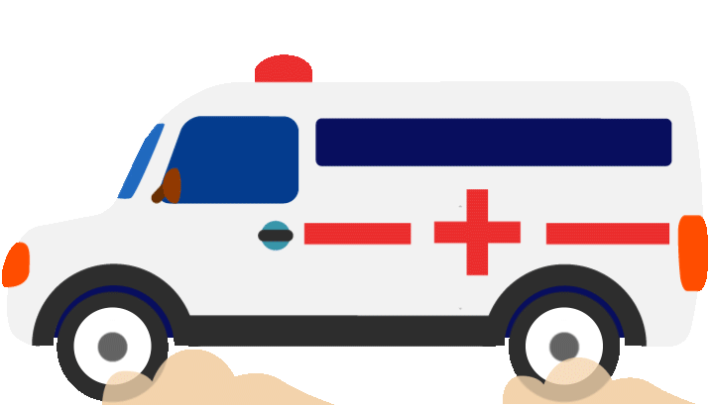
CWC, INC
COMMUNITY
WELLNESS
CAMPAIGN

Slide 2


statistics
Globally in 2022, there were an estimated 249 million malaria cases and 608 000 malaria deaths in 85 countries.
The WHO African Region carries a disproportionately high share of the global malaria burden.
In 2022, the Region was home to 94% of malaria cases (233 million) and 95% (580 000) of malaria deaths.
Children under 5 accounted for about 80% of all malaria deaths in the Region.
95%

Slide 3



PROBLEMS
01
HIGH OUTBREAK OF MALARIA
02
LIMITED HELTHCARE RESOURCES

Slide 4





SOLUTIONS
MSC
WPC
HECE
Mosquitos Spraying Campaign, with the right friendly environment and to people chemicals.
Water Purifications Campaign to clean available water to reduce/ nor control the population of malaria-carrying mosquitos
Health Educational Programs to teach about the dangers of Mosquitoes, ways to prevent the spreading of malaria, and ways to get help if one is sick or showing symptoms

Slide 5
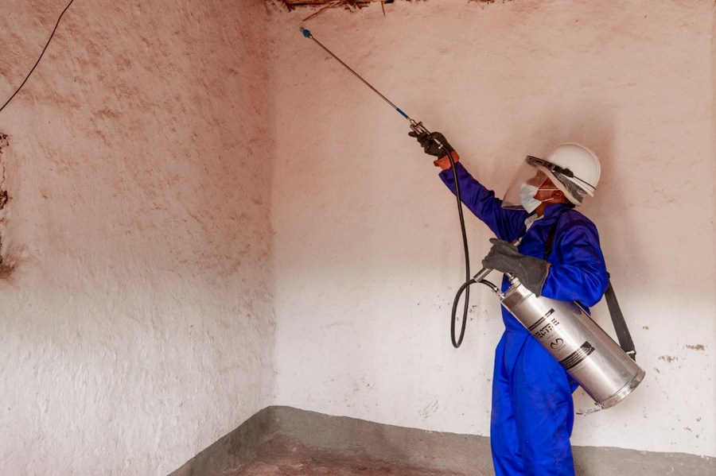
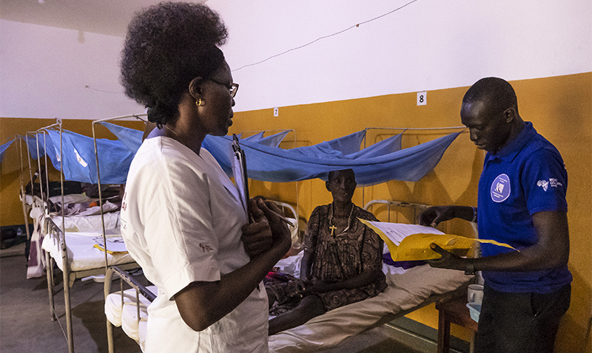
product
MSC
TRAINED OFFICIALS SPRAYING IN RURAL REGIONS TO HELP REDUCE THE SPREADING OF MALARIA AND REDUCE THE MALARIA CARRYING-MOSQUITOES.
HOME CELLS
Qualified nurses and Doctors doing home checkups to teach and do medical checkups to ensure that the spread and the virus of malaria and contained
Providing unlimited resources of medication to locals to ensure that everyone receives treatment and also teaching the ways to ensure people stay safe.

Slide 6




target market
Rural areas in South Africa as a Starter that have high number recorded of Malaria
The Program caters any people that is is suffering from the deadly virus of Malaria, but the main goal is to help the rurals due to limited resource reasons.
customers

Slide 7
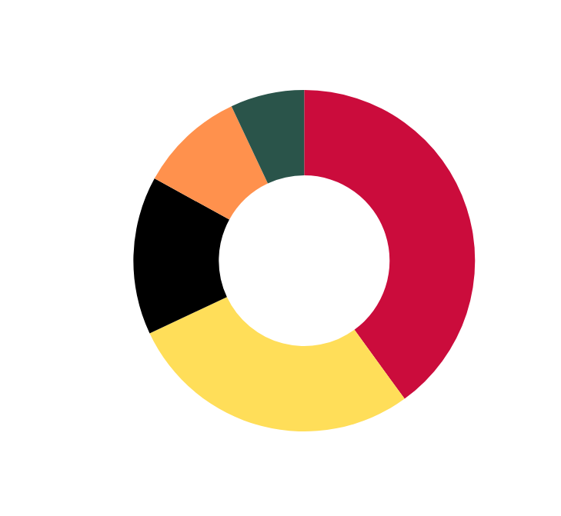

MARKET
SIZE
Chart comparing different areas with rural areas based on the recorded number of Malaria infections.

Slide 8

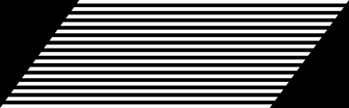
competition
rural malaria prevention
malaria eradication
Limited Healthcare Access: Difficulty in reaching remote rural populations with healthcare services, including diagnosis and treatment of malaria.
Logistical Issues: Challenges in distributing insecticide-treated bed nets (ITNs) and medications due to poor infrastructure and transportation networks.
Community Engagement: Low participation and compliance with preventive measures such as ITN use and indoor residual spraying (IRS) due to lack of awareness or cultural beliefs.
Sustainability: Difficulty in sustaining mosquito control efforts over time due to fluctuating funding and resources.
Healthcare Delivery: Inadequate healthcare facilities and trained personnel in rural areas to manage malaria cases effectively.
Environmental Factors: Persistent mosquito breeding sites and environmental conditions conducive to malaria transmission, challenging efforts to reduce mosquito populations.

Slide 9




competition advantage
service availability
The service offered by Community Wellness Campaign will be available 27/7 by those in need or in case of emergency.
engagement
Through Community engagement each week, we are able to combat the spread and teach about the Malaria virus and how to combat it on daily basis.
Presentation by Alexander Aronowitz | Business Marketing | 2024 | Rimberio University

Slide 10

timeline
The Campaign has already drafted a list of projects to combat with, to help manny communities grow.
Community based program to teach young and elders how to read, ride and speak communication language such as English
Issue of high crime rates in local communities and lack of protection from the law.
Issue of teenage pregnancy in local secondary schools and education about HIV/AIDS
Project 3
Project 1
Project 2

Slide 11
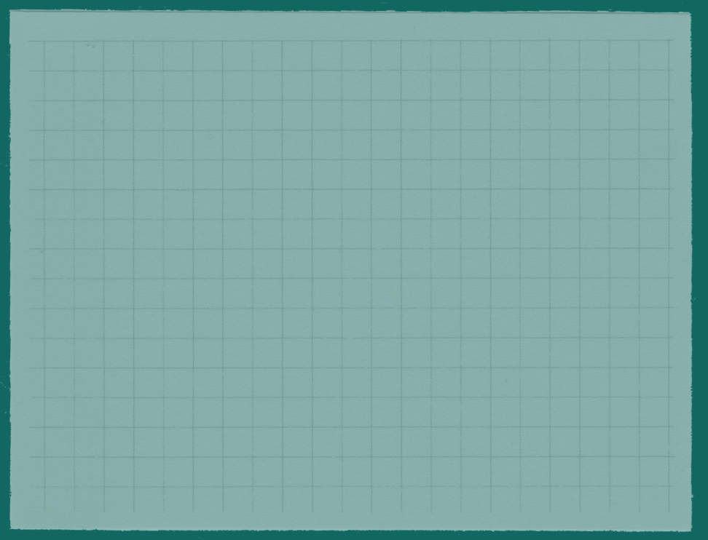




01.
Fellow Citizens belonging to the high class also contribute as little.
Business Model
02.
Big Companies Invest in the program, such as FNB, ABSA, Gift of the Givers, and many others that ensure that its communities do not perish due to Malaria.
Ways on how the campaign gains access to funds that keep the program running for the longest time.
03.
Funding Programs are initiated to ensure that all the needs like apparatus and to pay workers is always up.

Slide 12




go to market
Formation of partnership with local presentations to allow us bring the campaign so that people can be saved
Each week there be a mobile clinic to do checks up and reduce distance to hospitals since finance to limited in rural areas.
Announce on social media so that they know when and what time we will visit which community.
COLLABORATION COLLABORATION
mobile clinic
media

Slide 13






OUR ASK
Objectivs
Equipments
Purchase mosquito spraying equipment, diagnostic tools, and medical supplies.
Operation Costs
Support logistical expenses for mobile healthcare clinics and outreach activities.
Staff Salary
Support ongoing training and capacity building for medical staff and community health workers.
CWC
Sustainability
Seek partnerships with donors and stakeholders to diversify funding sources and secure continuous support.
Establish a reserve fund for emergency response and unforeseen operational challenges.

Slide 14

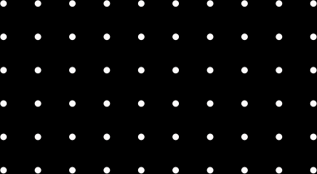
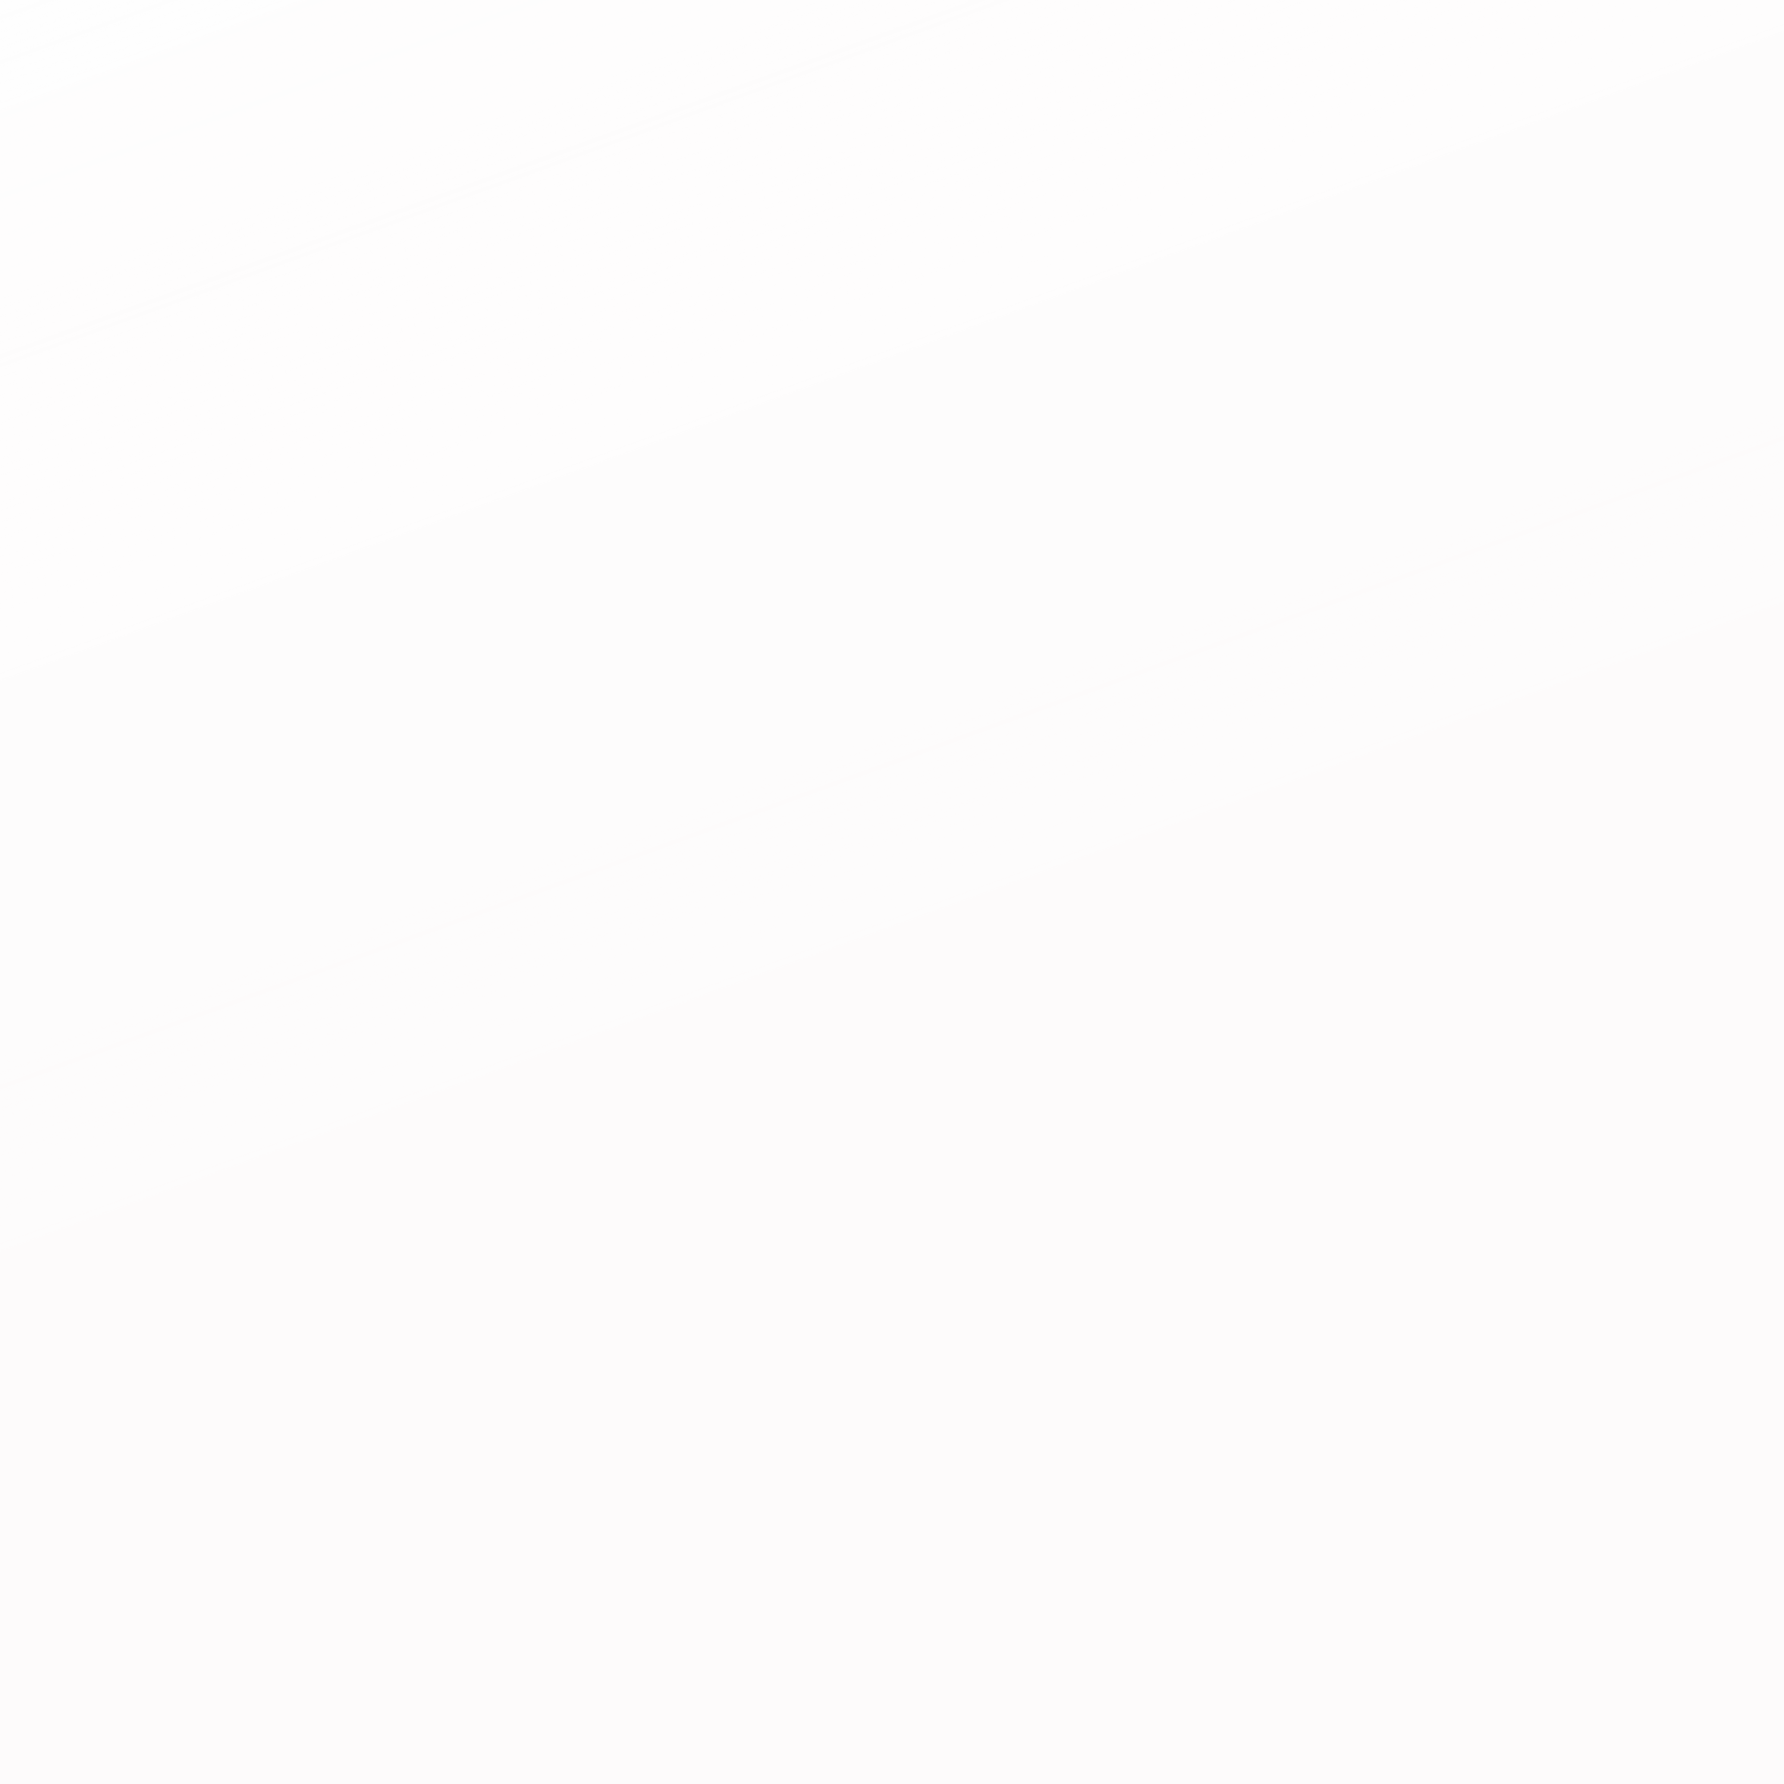
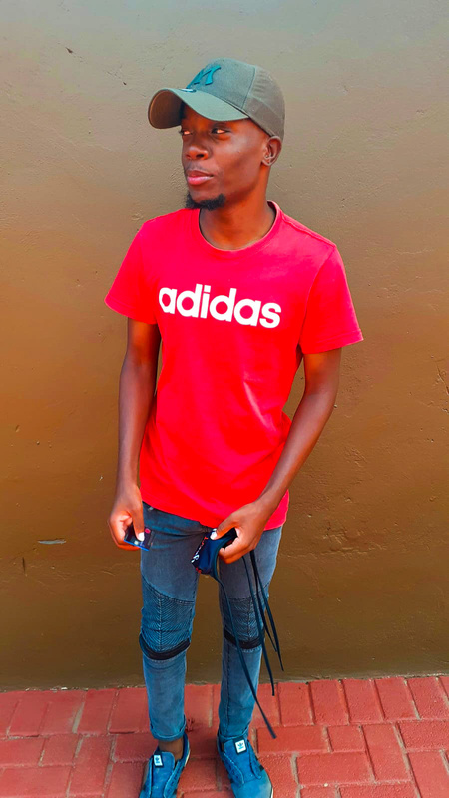

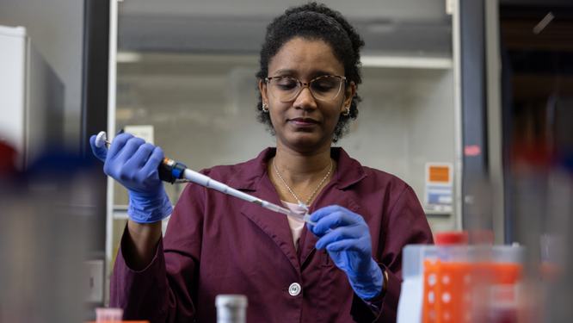



Our Team
Remy
Marsh
Everest Cantu
Drew Holloway
Morgan Maxwell
Founder
Marketing
Researcher
Doctors

